Slide 1
Web Project
TO Do List
Submitted to – Mr. Pratik Shrivastva
Submitted by -Abhinav singwal

Slide 2

To do List

Slide 3
What is to-do list ?
By keeping such a list, you make sure that your tasks are written down all in one place so you don't forget anything important. And by priority tasks, you plan the order in which you'll do them, so that you can tell what needs your immediate attention, and what you can leave until later.

Slide 4
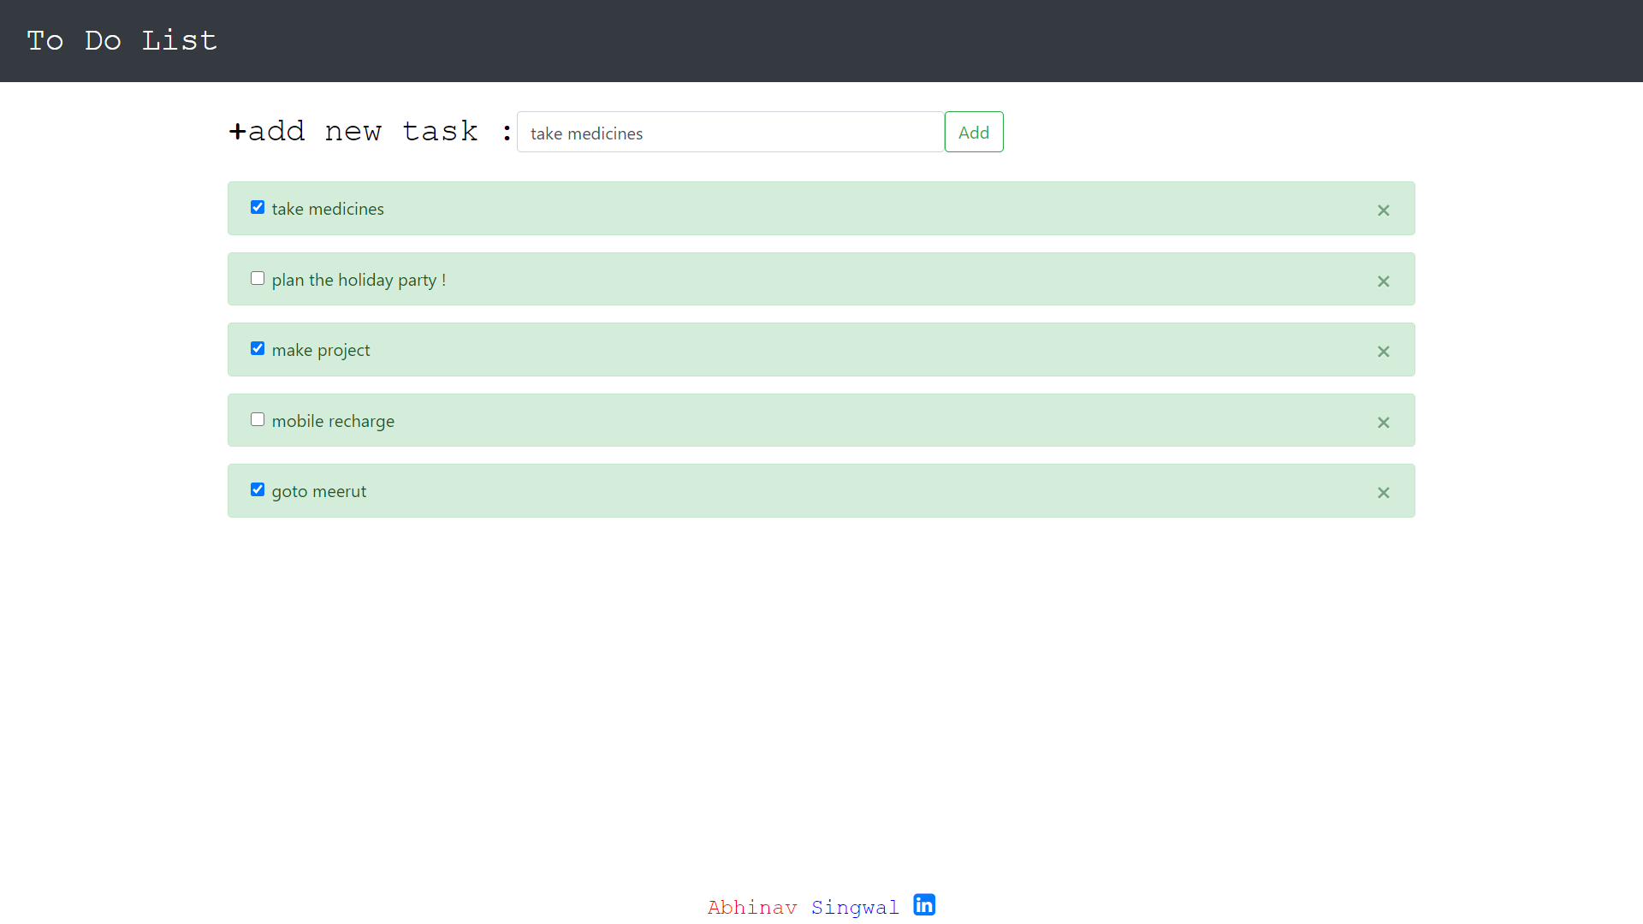

Slide 5
Technology Used
HTML
CSS
JavaScript
Bootstrap
JQuery

Slide 6
HTML
HTML is the standard markup language for Web pages.

Slide 7
CSS
CSS describes how HTML elements are to be displayed on screen, paper, or in other media

Slide 8
javaScript
JavaScript is a scripting language that enables you to create dynamically updating content

Slide 9
Bootstrap
Bootstrap is the most popular CSS Framework for developing responsive and mobile-first websites.

Slide 10
jQuery
jQuery is a JavaScript library. jQuery greatly simplifies JavaScript programming. ... With jQuery, you can hide and show HTML elements

Slide 11
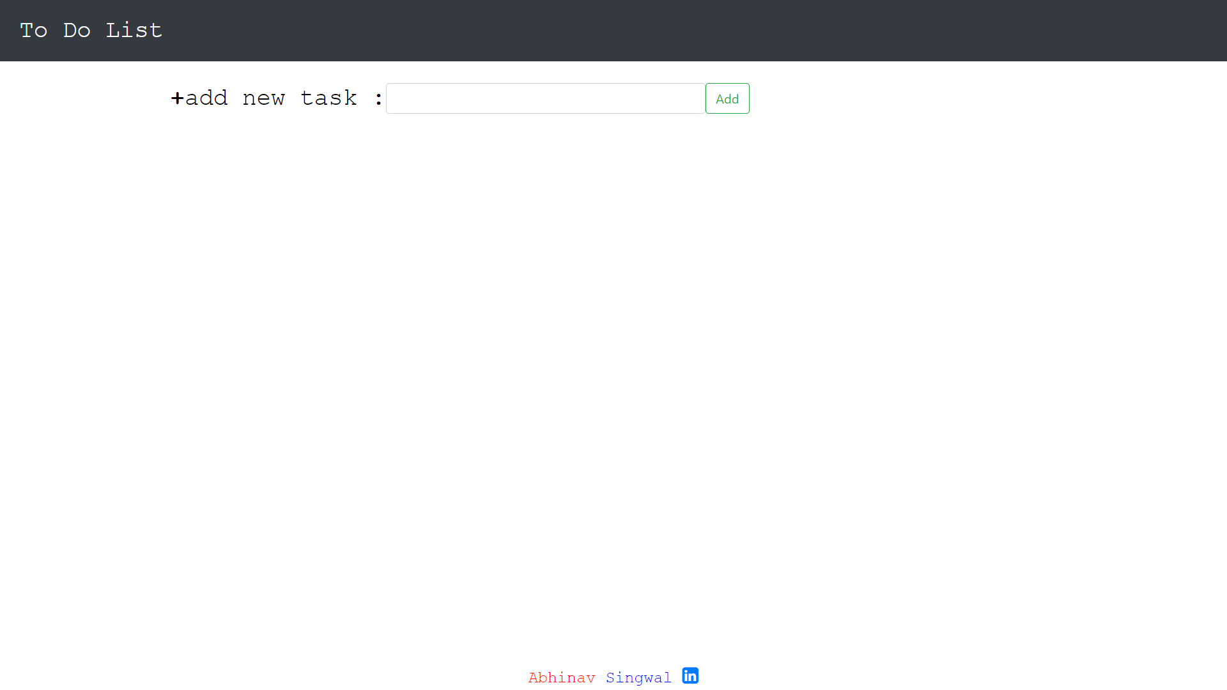

Slide 12
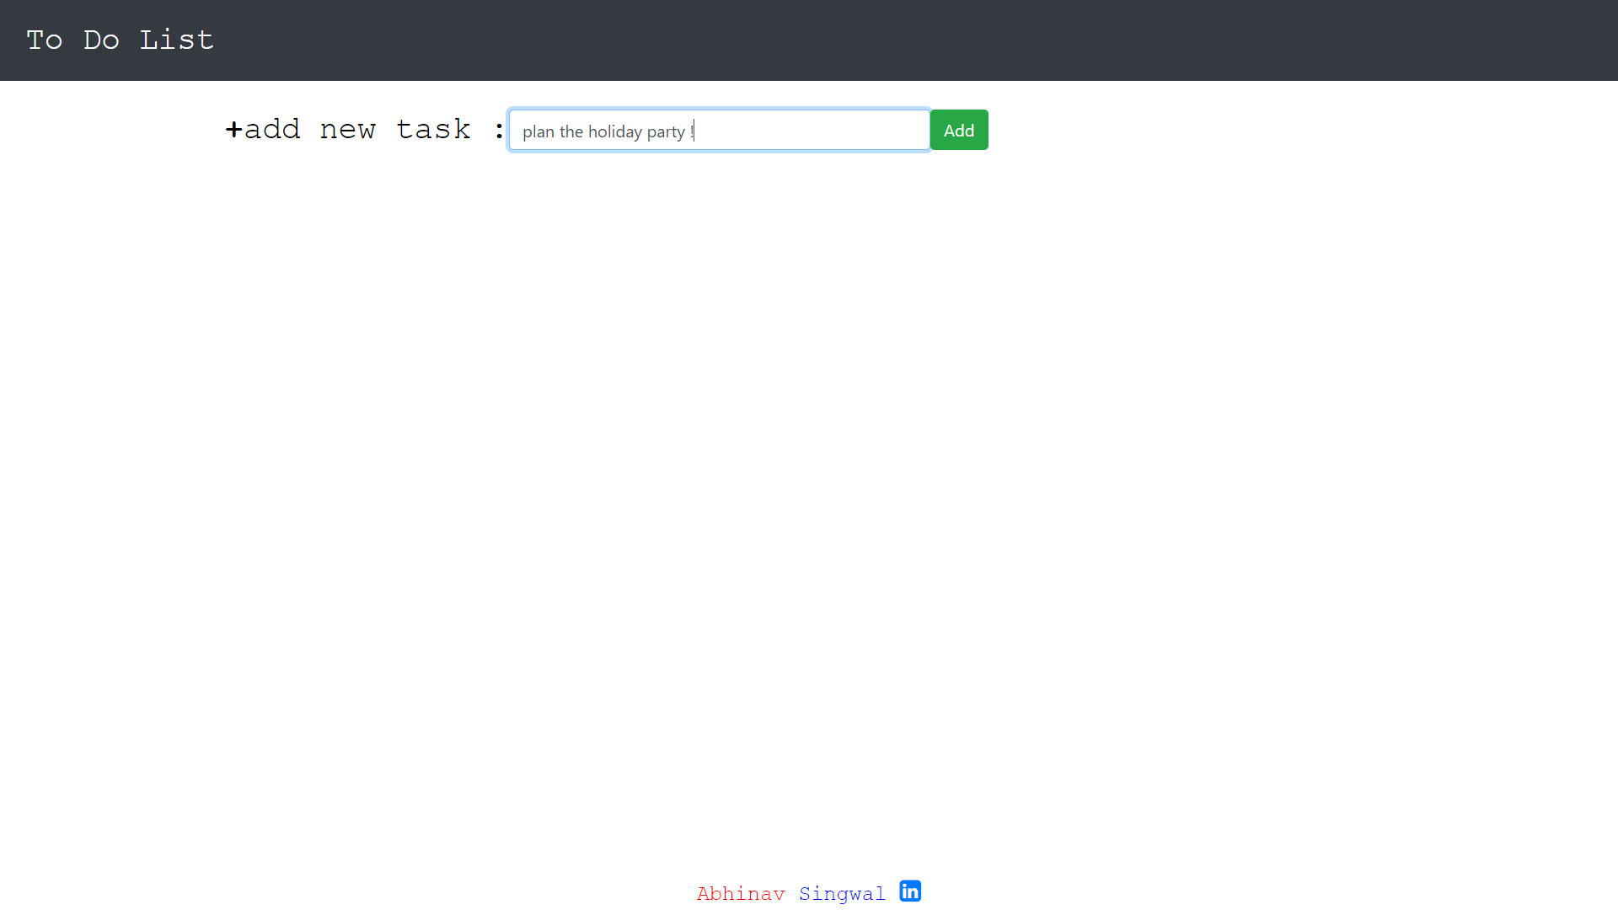

Slide 13
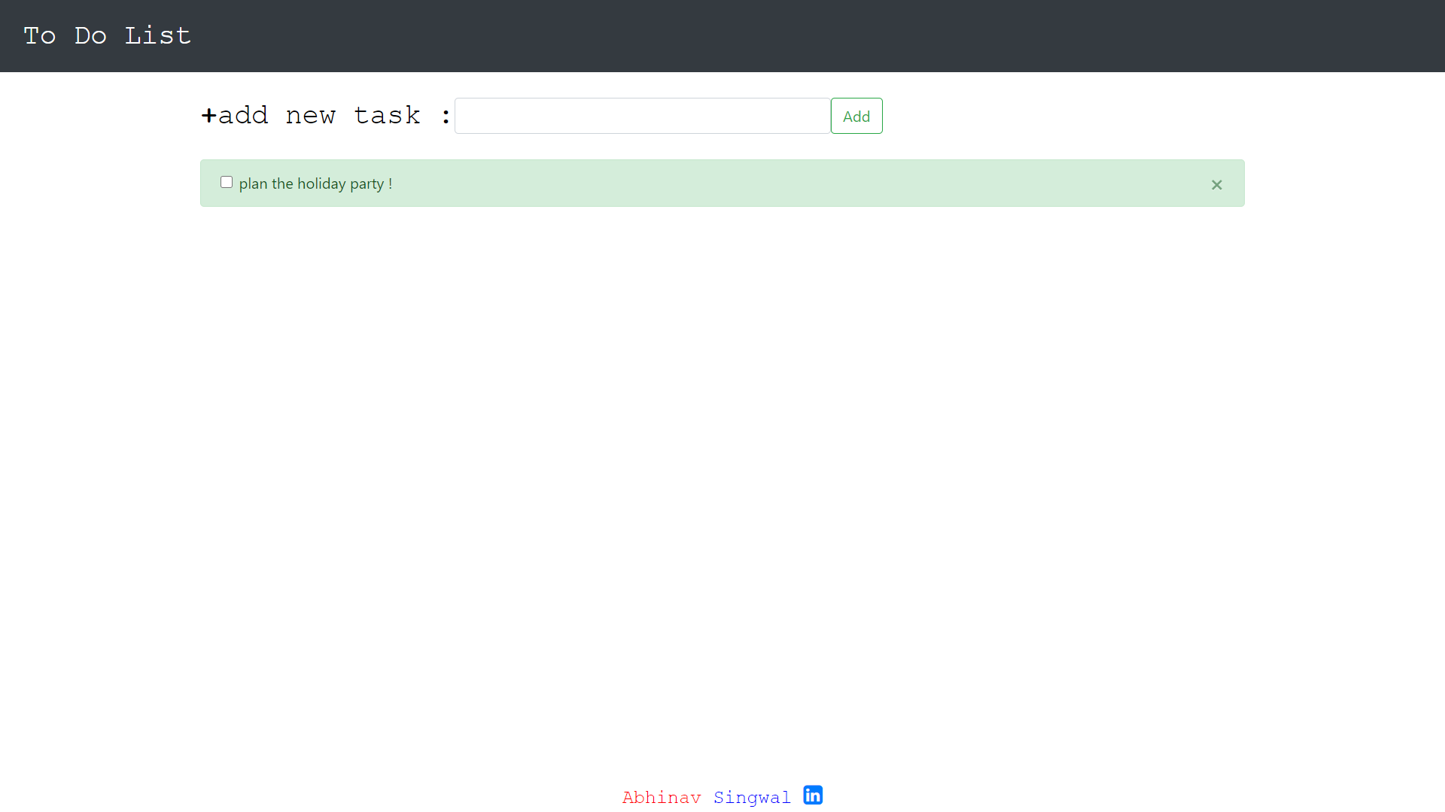

Slide 14
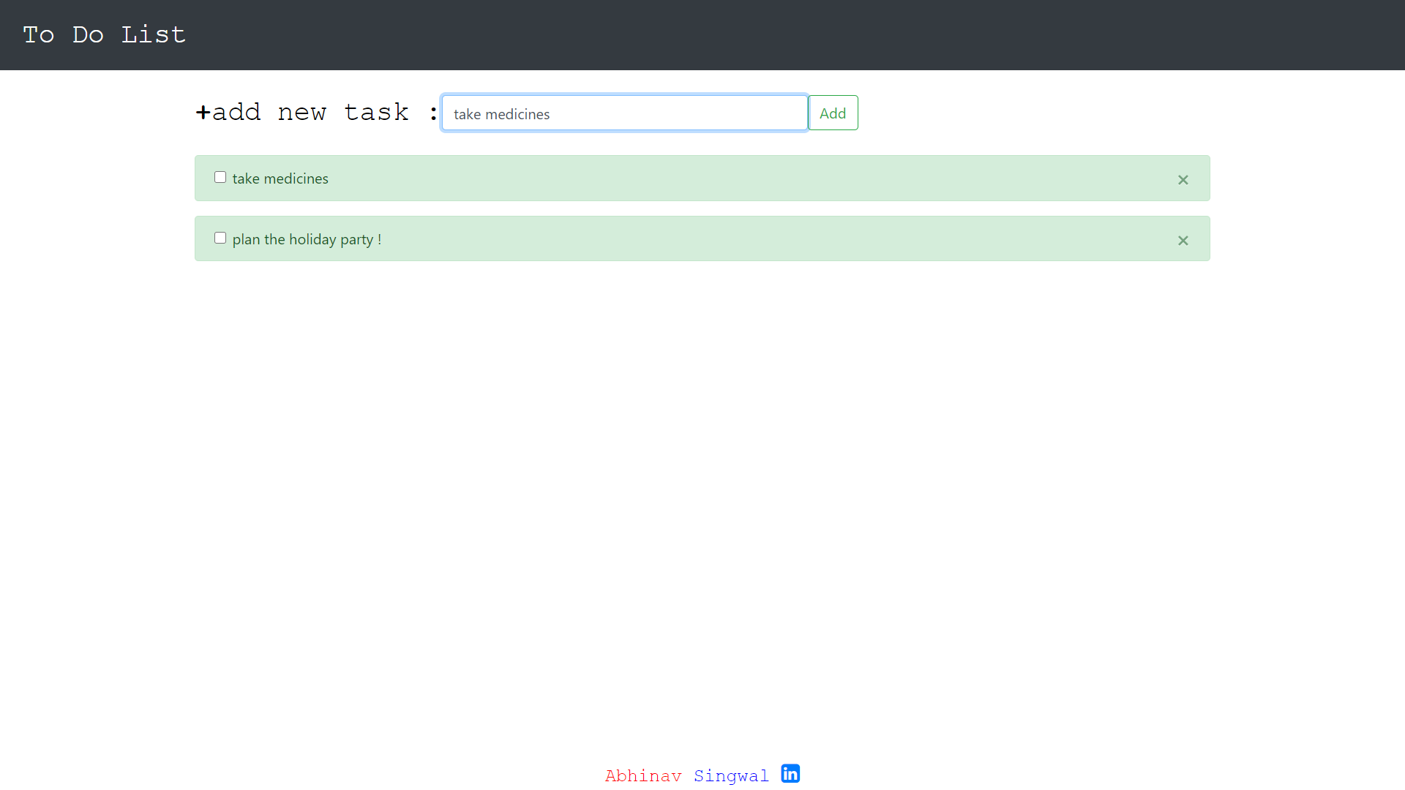

Slide 15
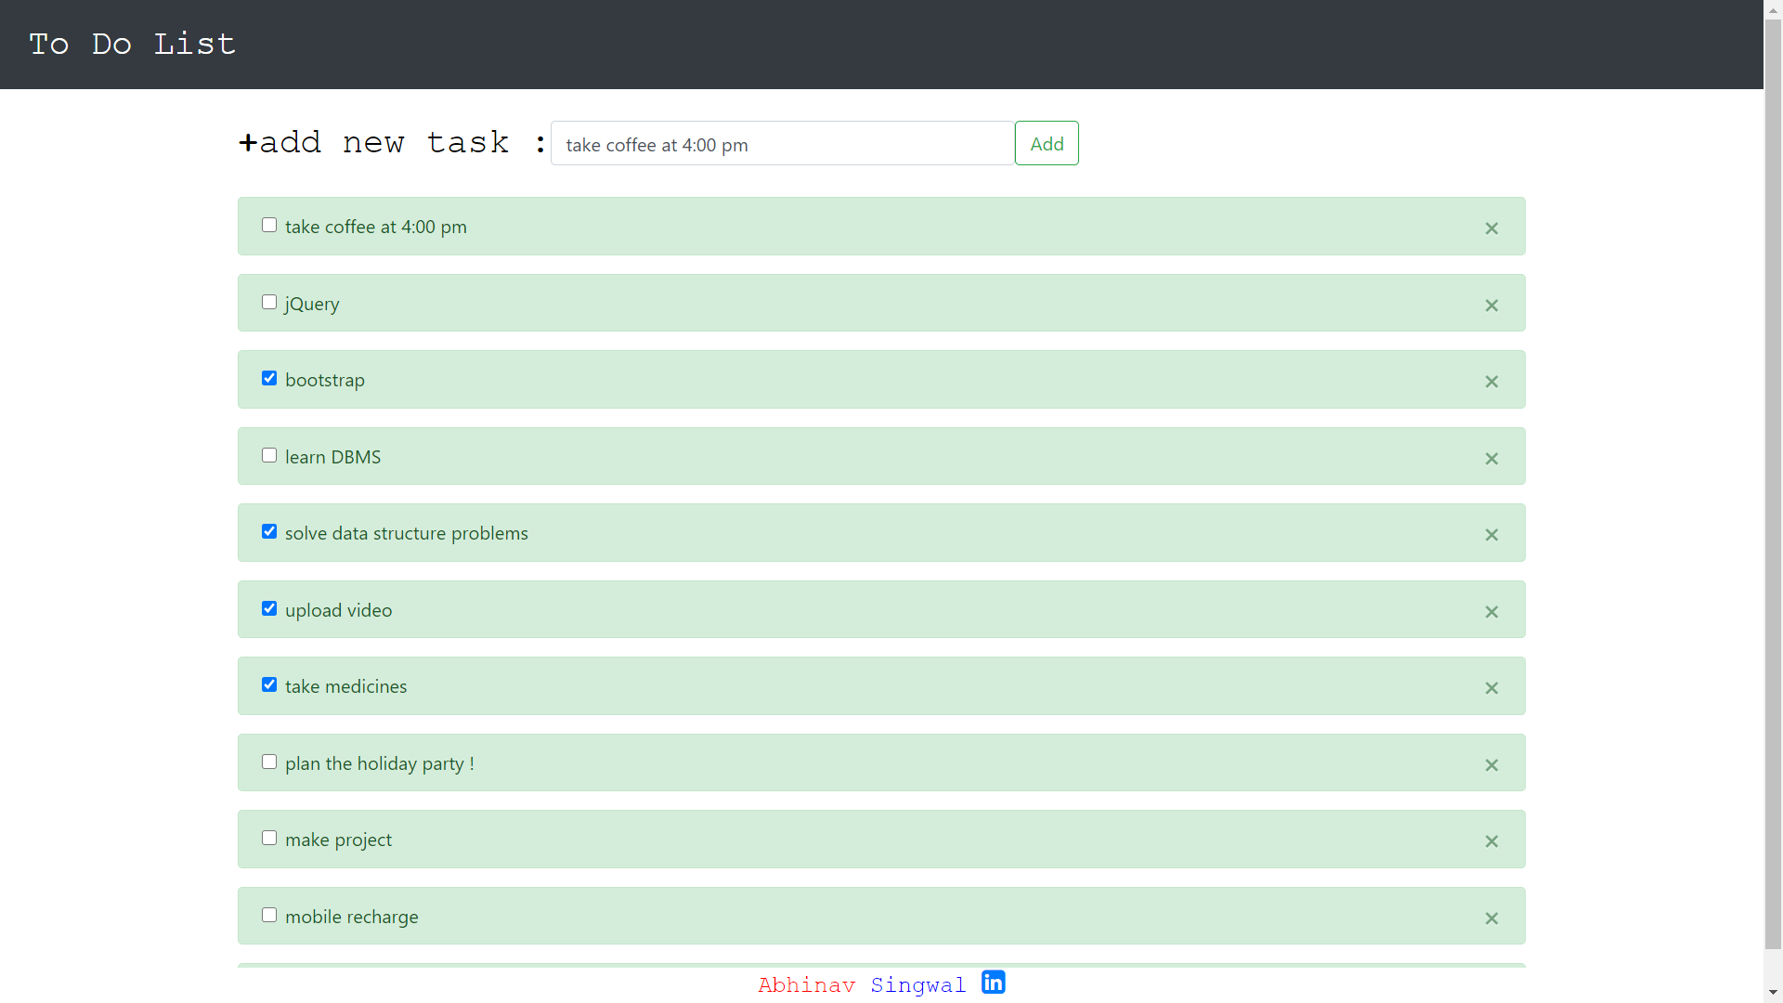
System Design

Slide 16
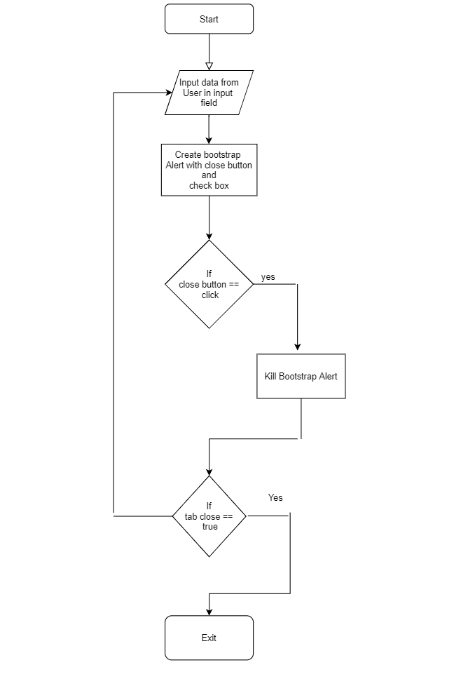
Flowchart

Slide 17
Thank You

